Slide 1
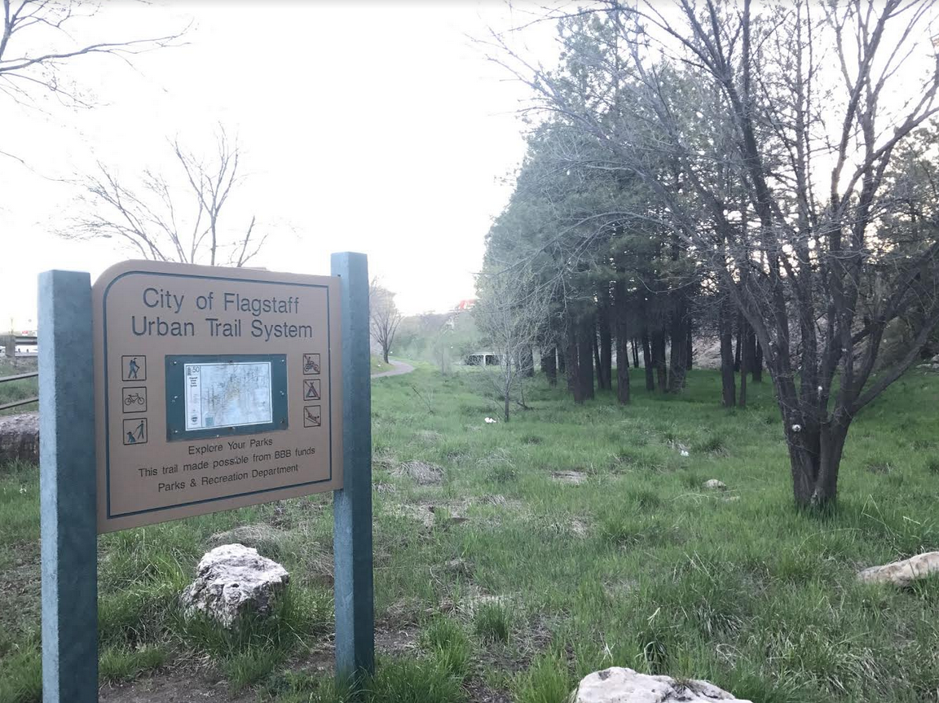


Sinclair Wash Stream Restoration Feasibility Study
CENE 486C
April 28, 2017
Abdullah Alsalman
Ahmad Alnemash
Abdulrahman Alsabah
Mohamed Alhassani

Slide 2


Acknowledgment
Client & Technical Adviser: Mark Lamer
Grading Instructor: Dr. Wilbert Odem

Slide 3




Project Stakeholders
City of Flagstaff
Arizona Department of Transportation
Northern Arizona University
Coconino County
City of Flagstaff Community
Arizona Game and Fish Department
Notes:
Mohamed

Slide 4
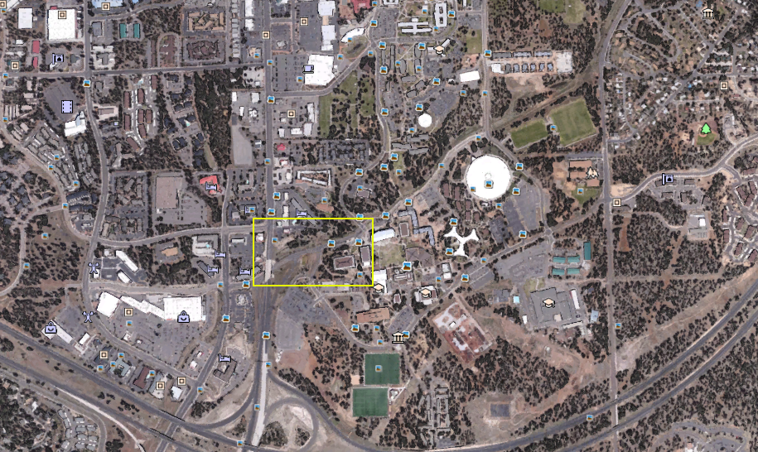
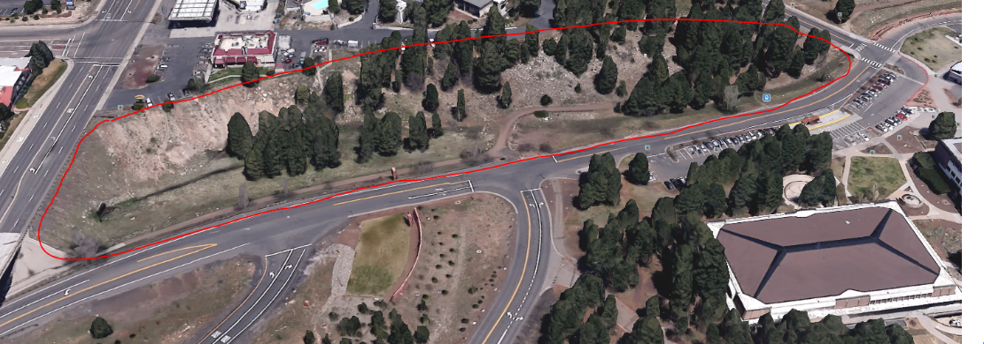
Project Overview
Reach Location
Sinclair Wash Location
Selected Reach Location
Reach Current Condition
Project Purpose
Milton Rd
NAU Skydome
Highway I-17
Sinclair Wash Reach Location [1]
Selected Reach
Reach Aerial Image [2]

Slide 5
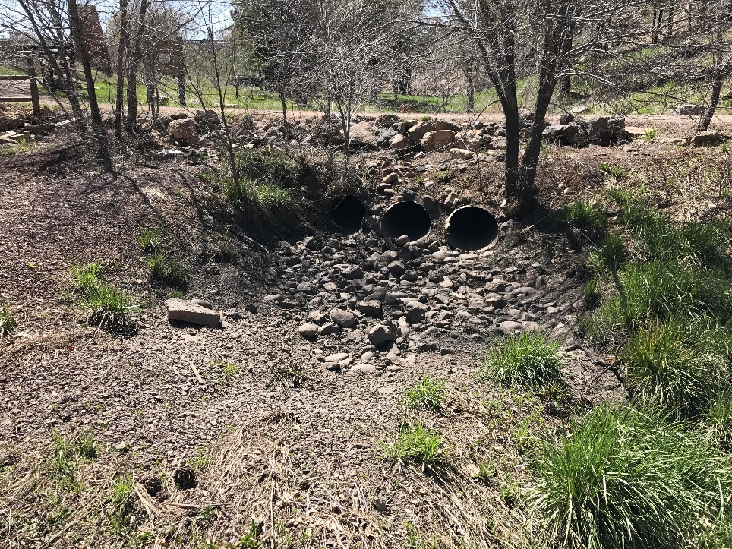
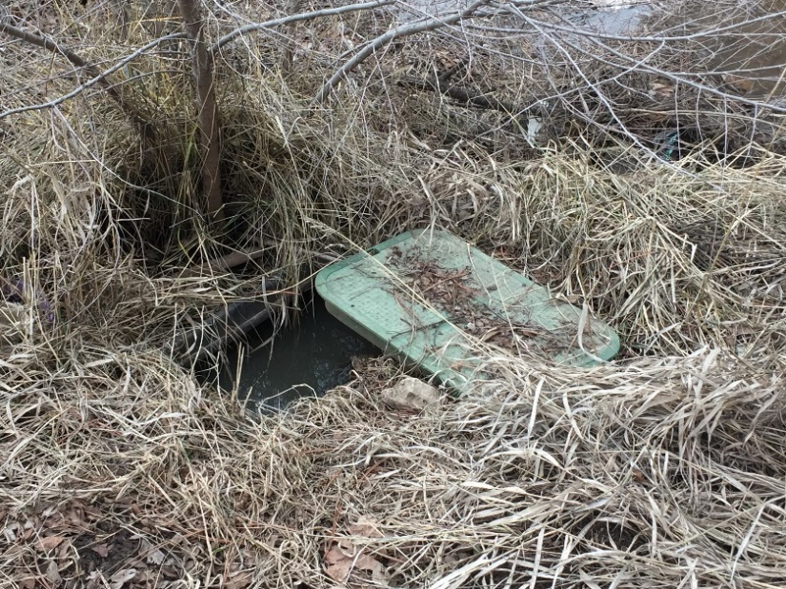
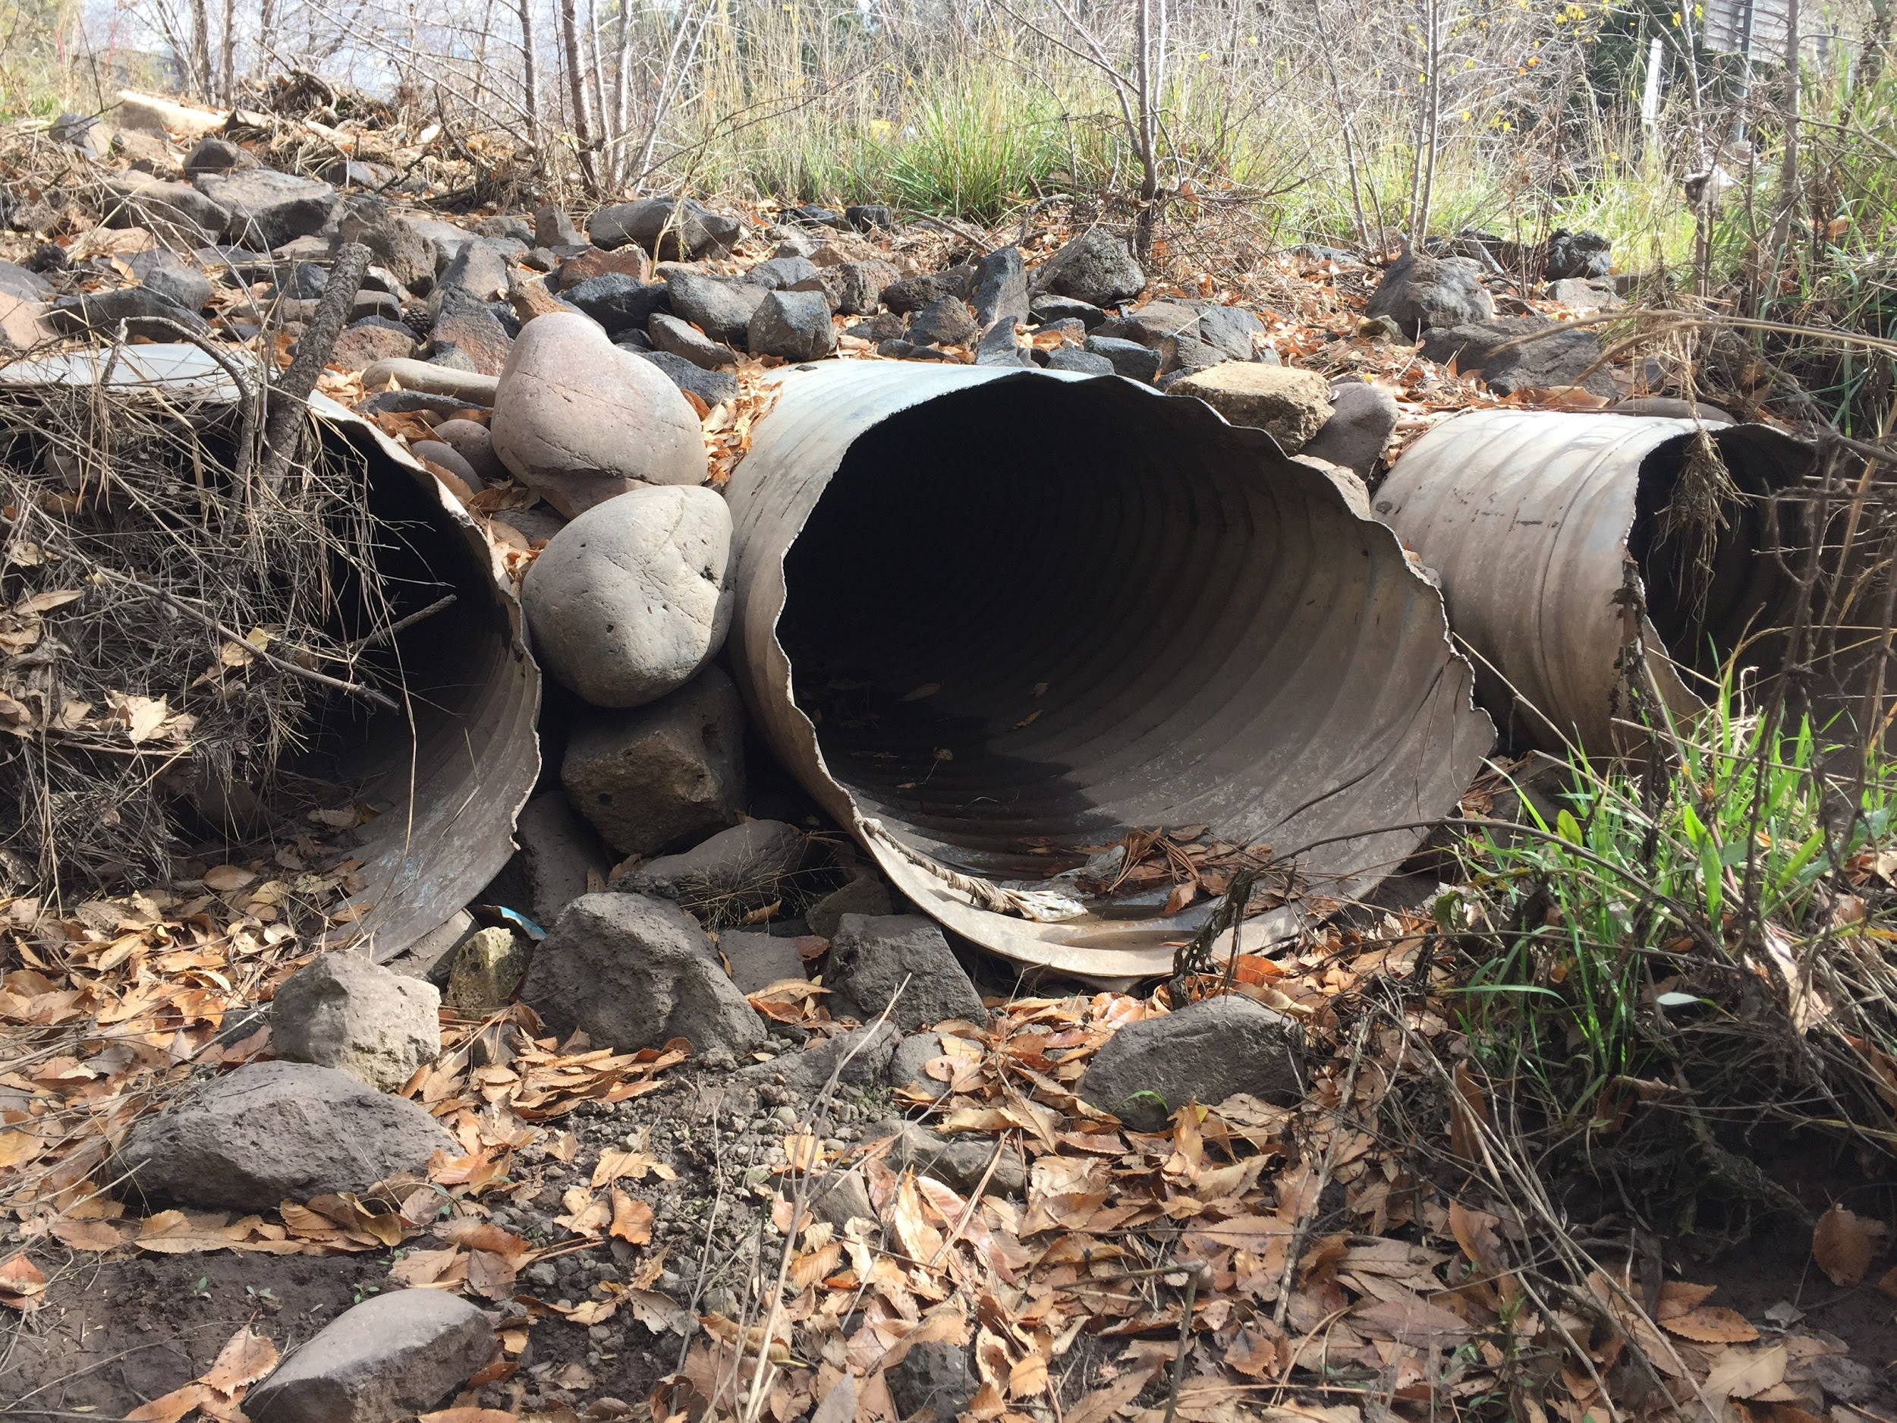
Reach Assessment
Field Assessment
Scour Pool [3]
Open Valve Box in the Reach [4]
Culverts in the Reach [5]

Slide 6
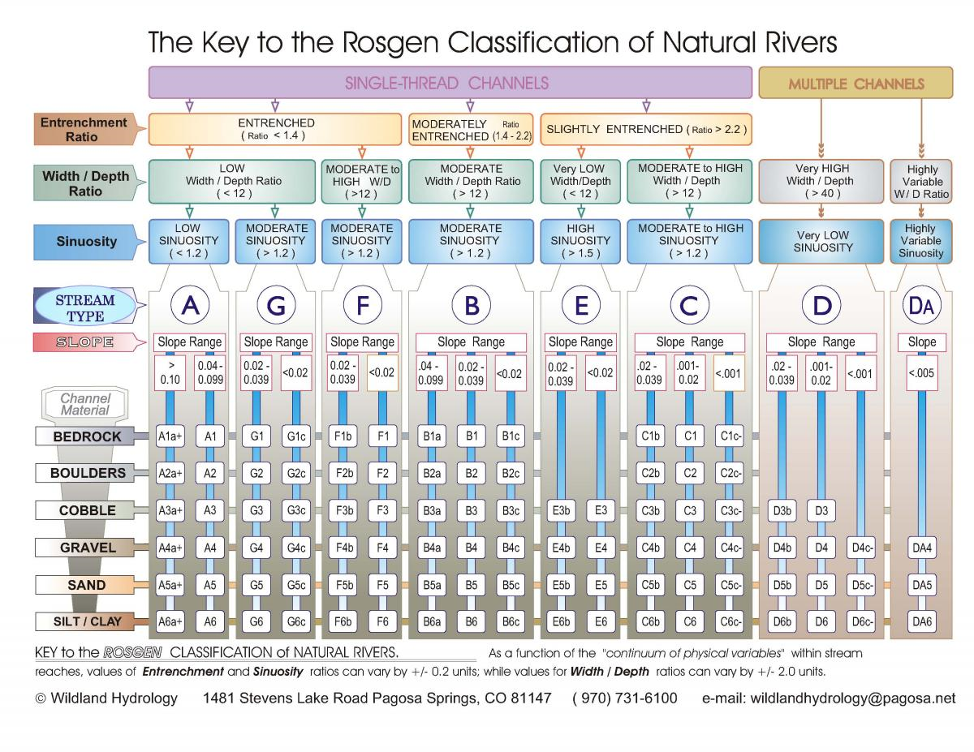
Geomorphic Assessment
Table 1: Stream Classification
Location | I-17 East McConnell Drive
Bankfull WIDTH (ft) | 73.79
Channel Bottom Width (ft) | 18.00
Bankfull DEPTH (ft) | 5.25
Bankfull X-Section AREA (ft^2) | 240.95
Width/Depth Ratio | 14.06
Maximum DEPTH (ft) | 5.33
WIDTH of Flood-Prone Area (ft) | 10.67
Entrenchment Ratio | 0.14
Channel Material Size (mm) | 3.00
Water Surface Slope | 0.01
Channel Sinuosity | 1.3
Stream Classification | F
Rosgen Classification Method [6]

Slide 7
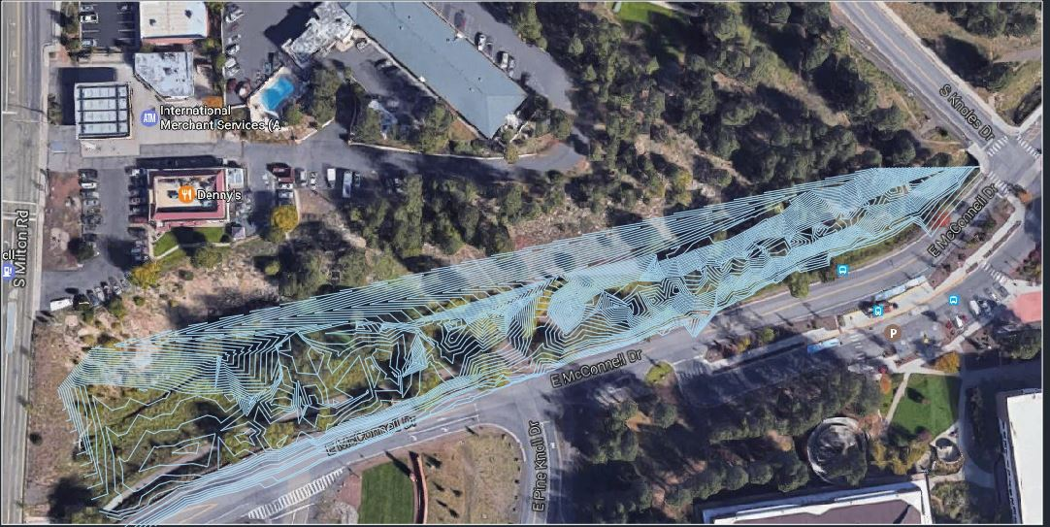
Reach Surveying
Total Station Surveying
Surveying Challenges
Reach Topo Map [7]

Slide 8
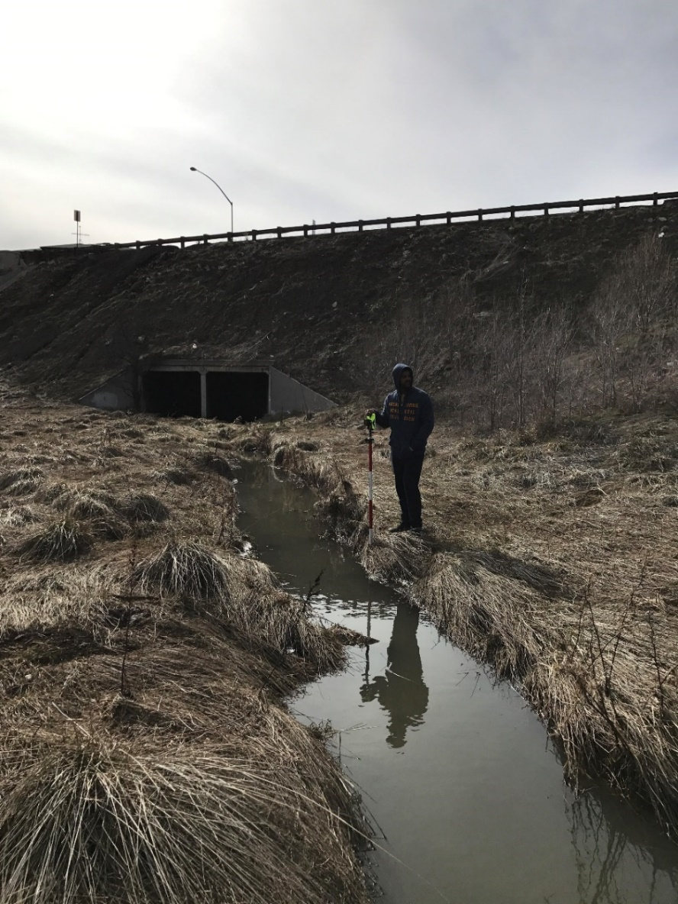
Hydraulics Assessment
Existing Conditions Model
Challenges
- Inlet Cross-Section
Assumptions
Table 2: Flow Rates in the Reach
Storm Event | 2-year | 10-year | 50-year | 100-year
Flow Rate (CFS) | 130 | 350 | 670 | 890
Surveying The Reach [8]

Slide 9
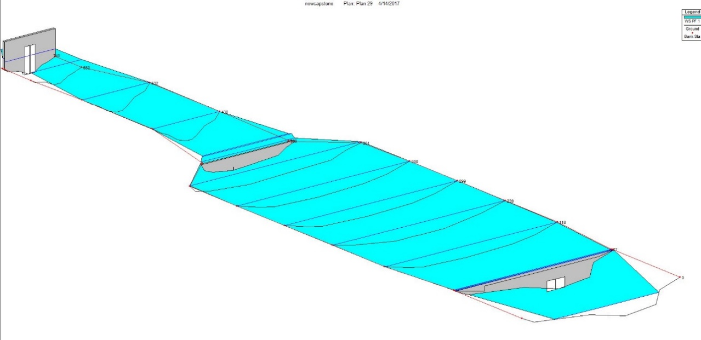
Hydraulics Assessment
Existing Conditions Model
HEC-RAS Model
I-17 Culvert
FUT Culvert
S Knoles Culvert
Flow
Profile View of 100-yr Existing Condition Model [9]

Slide 10
Hydraulics Assessment
Existing Conditions Model
Table 3: HEC-RAS Results for Current Conditions 100-year flow
Station | Flow Rate (CFS) | Velocity (ft/s) | Allowable Down Stream Velocity (ft/s) | W.S Elevation (ft)
740 | 890 | 1.8 | 2.5 | 1002
650 | 890 | 2.1 | 2.5 | 1002
532 | 890 | 2.2 | 2.5 | 1002
430 | 890 | 2.3 | 2.5 | 1002
380 | 890 | 2.2 | 2.5 | 1000
301 | 890 | 2.5 | 2.5 | 1000
300 | 890 | 2.4 | 2.5 | 1000
299 | 890 | 2.5 | 2.5 | 1000
220 | 890 | 2.7 | 2.5 | 999.6
118 | 890 | 2.9 | 2.5 | 999.6
77 | 890 | 2.9 | 2.5 | 999.6
10 | 890 | 1.6 | 2.5 | 997.5
3 | 890 | 1.6 | 2.5 | 997.5

Slide 11

Hydraulics Assessment
Conditions of the Section
Unhealthy Section
XS-220
XS-118
Scour Pool
XS-77
Unhealthy Cross Sections at the Reach [10]
Unhealthy Section in the Reach [11]
Table 5: Culvert Velocities at Unhealthy Cross Sections
Table 4: Velocities at Unhealthy Cross Sections
Culvert | Storm Event | Exit Velocity (ft/s) | Allowable Down Stream Velocity (ft/s)
FUT | 2 | 2.8 | 2.5
FUT | 10 | 5.8 | 2.5
FUT | 50 | 6.2 | 2.5
FUT | 100 | 6.8 | 2.5
Storm Event | Cross- Section | Velocity (ft/s) | Allowable Down Stream Velocity (ft/s)
2 year | 118, 220 | 3.2 | 2.5
10 year | 77, 118 | 2.6 | 2.5
50 year | 77, 118 | 2.7 | 2.5

Slide 12
Hydraulics Assessment
Unhealthy Section
Reference Reach
Bankfull Characteristics
Low Water Crossing Design
Improved Section

Slide 13
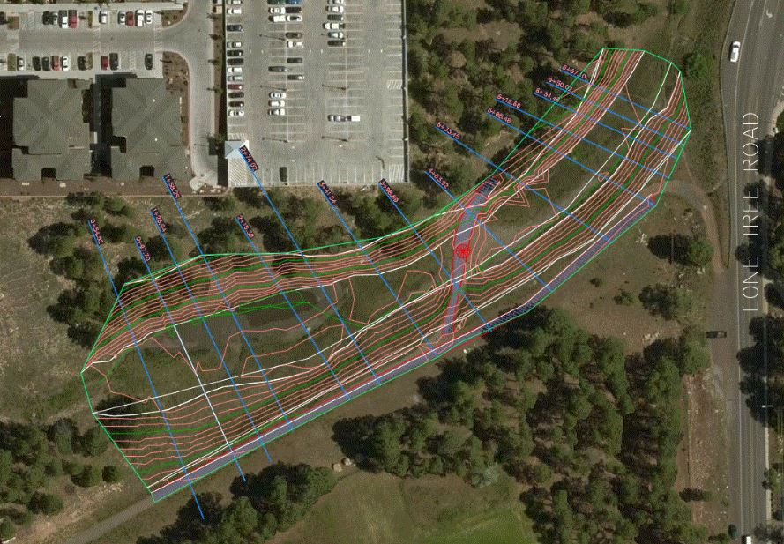
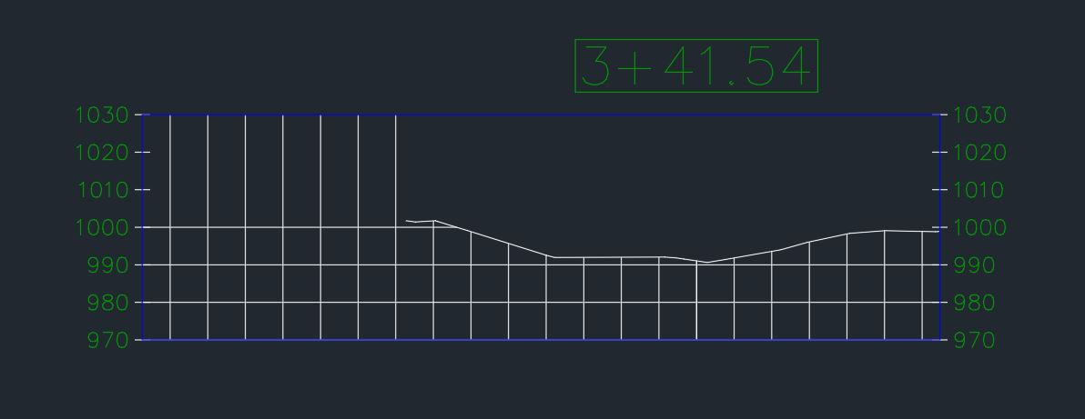
Hydraulics Assessment
Proposed Conditions Model
Bankfull
Bankful Location in Reference Reach [13]
Healthy Reference Reach [12]
Table 6: Reference Reach Bankfull Characteristics
Reference Reach | Bankfull Width (ft) | Bankfull Depth (ft) | Bankfull X-section Area (ft^2)
San Francisco& S Lone Tree | 23 | 1.5 | 44

Slide 14
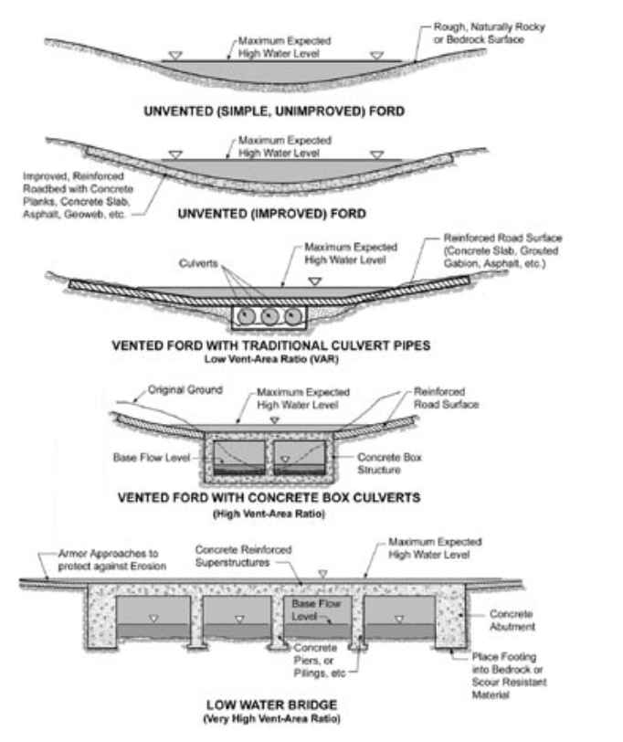
Hydraulics Assessment
Low Water Crossing Design
Design Consideration
Table 7: Low Water Crossing Design Results
Low Crossing Type | Low Crossing Material | Concrete Slab Thickness (inch) | Roughness Coefficient (n)
Unvented Ford | Concrete | 6 | 0.016
USDA Low Water Crossing Types [14]

Slide 15
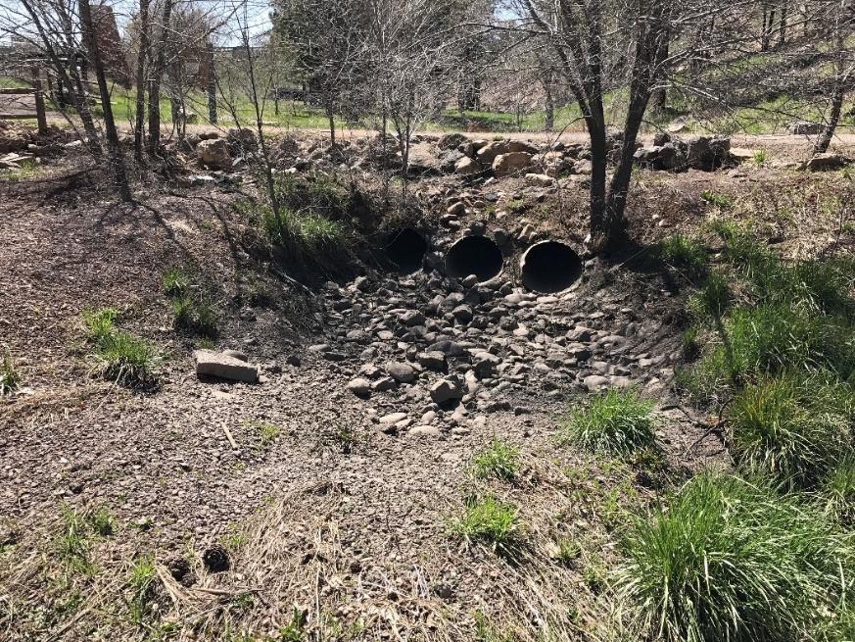
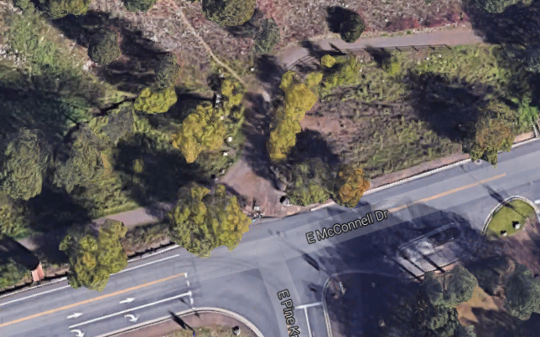
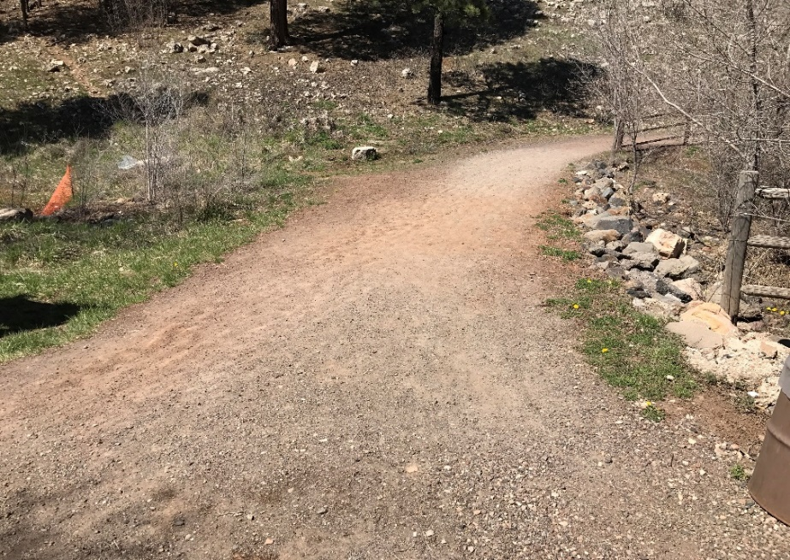
Low Water Crossing Design
Existing Crossing at the Reach
Used for Flagstaff Urban Trail System
Existing Crossing [16]
Aerial Picture of the Existing Crossing [15]
Existing Crossing [17]

Slide 16
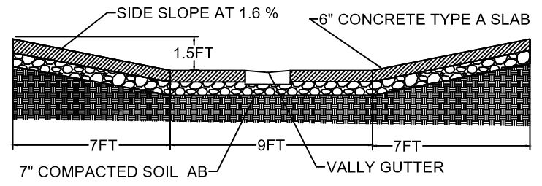
Low Water Crossing Design
Bankfull Characteristics
Valley Gutter
Low Water Crossing Design [18]

Slide 17
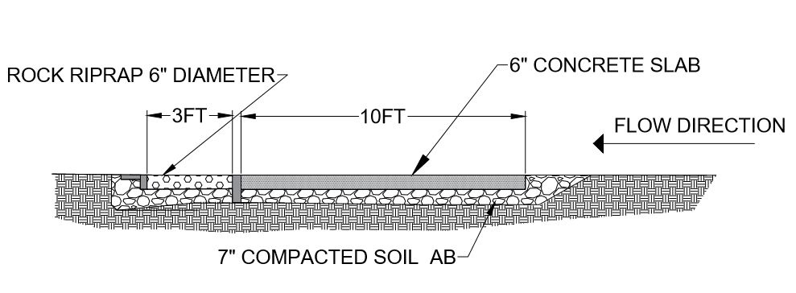
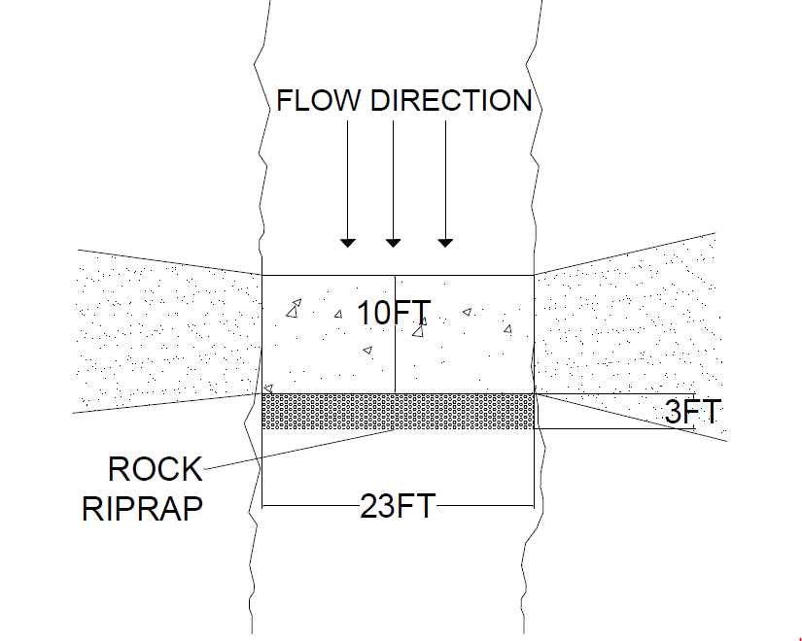
Low Water Crossing Design
High Velocities
Riprap Design
Section View of Low Water Crossing Design [20]
Table 8: Riprap Design Results
Riprap Type | D min (inch) | D 50 (inch) | D max (inch) | Riprap Extend (ft) | Riprap Volume (ft^3) | Roughness Coefficient (n)
Rock | 3 | 6 | 12 | 3 | 115 | 0.035
Plan View of Low Water Crossing Design [19]

Slide 18
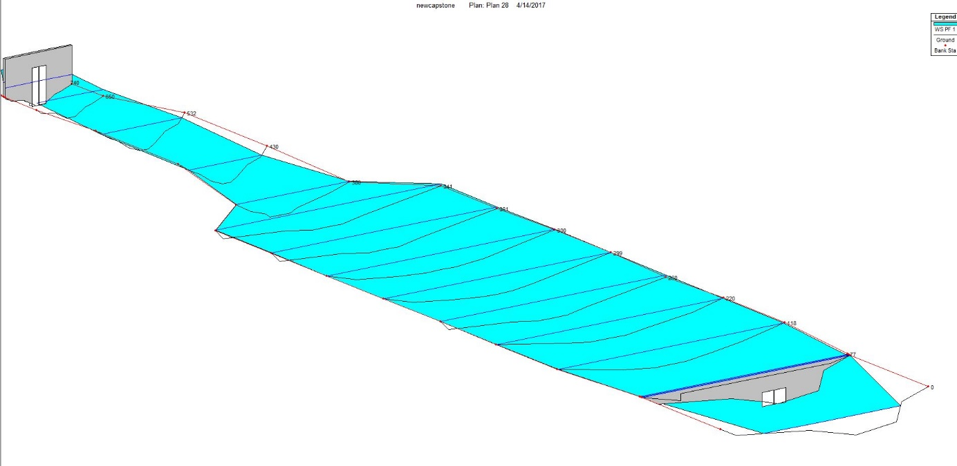
Hydraulics Assessment
Proposed Conditions Model
New Low Water Crossing
Profile View of Proposed Conditions Model at 100-year Flow [21]

Slide 19
Hydraulics Assessment
Proposed Conditions Model
Table 9: HEC-RAS Results for Proposed Conditions 100-year flow
Station | Flow Rate (CFS) | Velocity (ft/s) | Allowable Down Stream Velocity (ft/s) | W.S Elevation (ft)
740 | 890 | 1.8 | 2.5 | 1002
650 | 890 | 2.1 | 2.5 | 1002
532 | 890 | 2.2 | 2.5 | 1002
430 | 890 | 2.3 | 2.5 | 1002
380 | 890 | 2.2 | 2.5 | 1000
301 | 890 | 1.5 | 2.5 | 1000
300 | 890 | 1.7 | 2.5 | 1000
299 | 890 | 1.6 | 2.5 | 1000
220 | 890 | 1.8 | 2.5 | 999.6
118 | 890 | 1.7 | 2.5 | 999.6
77 | 890 | 1.4 | 2.5 | 999.6
10 | 890 | 1.5 | 2.5 | 997.5
3 | 890 | 1.5 | 2.5 | 997.5
Table 11: Unhealthy Cross Sections Proposed Condition

Slide 20


Hydraulics Assessment
Existing Conditions Model Vs Proposed Condition Model
FUT Culvert
New Low Water Crossing
Profile View of Existing Conditions Model at 100-year Flow [22]
Profile View of Proposed Conditions Model at 100-year Flow [23]
Table 10: HEC-RAS Existing Conditions Model Results
Table 11: HEC-RAS Proposed Conditions Model Results
Storm Event | Cross- Section | Velocity (ft/s) | Allowable Down Stream Velocity (ft/s)
2 year | 118, 220 | 3.2 | 2.5
10 year | 77, 118 | 2.6 | 2.5
50 year | 77, 118 | 2.7 | 2.5
Storm Event | Cross- Section | Velocity (ft/s) | Allowable Down Stream Velocity (ft/s)
2 year | 118, 220 | 1.6 | 2.5
10 year | 77, 118 | 2.3 | 2.5
50 year | 77, 118 | 2.2 | 2.5

Slide 21
Project Schedule
Table 12: Expected Project Schedule Vs Actual Project Schedule
Task | Expected | Actual
1.0 Site Visit | 11/21/2016 | 11/21/2016
1.1 Filed Assessment | 11/7/2016 | 11/7/2016
1.2 Sinclair Wash Document | 11/14/2016 | 11/14/2016
1.3 Infrastructure Assessment | 11/21/2016 | 11/21/2016
2.0 Data Collection | 12/2/2016 | 1/2/2017
2.1 Surveying | 11/26/2016 | 1/2/2017
3.0 Data Analysis | 2/20/2017 | 2/25/2017
3.1 Geomorphic Assessment | 2/10/2017 | 2/12/2017
3.2 Hydraulic Assessment | 2/17/2017 | 2/20/2017
3.2.1 Existing condition Model | 2/17/2017 | 2/20/2017
3.2.2 Proposed Condition Model | 2/19/2017 | 2/22/2017
4.0 Design Alternative | 3/20/2017 | 4/10/2017
4.1 Low Water Crossing | 3/27/2017 | 4/1/2017
5.0 Project Management | 5/9/2017 | 5/9/2017
5.1 50% Report | 3/2/2017 | 3/2/2017
5.2 Final Presentation | 4/28/2017 | 4/28/2017
5.3 Final Report | 5/9/2017 | 5/9/2017

Slide 22
Project Hours Breakdown
Table 13: Predicited Project Hours
Task | Project Manager Hours | Project Engineer Hours | Lab Technician Hours | Engineer in Training | Intern Hours
1.0 Filed Assessment | 3 | 5 | 15 | 20 | 35
2.0 Data Collection | 1 | 20 | 85 | 90 | 55
3.0 Data Analysis | 2 | 30 | 35 | 95 | 75
4.0 Design Alternative | 2 | 25 | 20 | 10 | 35
5.0 Project Management | 72 | 50 | 35 | 5 | 35
Total | 80 | 130 | 190 | 220 | 235
 | 855
Table 14: Actual Project Hours
Task | Project Manager Hours | Project Engineer Hours | Lab Technician Hours | Engineer in Training | Intern Hours
1.0 Filed Assessment | 3 | 6 | 12 | 25 | 35
2.0 Data Collection | 3 | 24 | 82 | 98 | 55
3.0 Data Analysis | 2 | 28 | 39 | 95 | 75
4.0 Design Alternative | 3 | 28 | 24 | 15 | 35
5.0 Project Management | 72 | 52 | 36 | 8 | 35
Total | 83 | 138 | 193 | 241 | 235
 | 890

Slide 23
Project Implementation Cost
Table 15: Predicited Project Costs
Item | Unit | Quantity | Unit Cost | Total
Earth Work | 40 (yard) | 1 | 8 $ per yard | 320 $
Culvert Removal | 18 (Square feet) | 3 | 16 $ per square feet | 288 $
Concrete Slab | 230 (Square feet) | 1 | 8 $ per square feet | 1840 $
Riprap | 20 (Square yard) | 1 | 40 $ per square yard | 800 $
Total Cost | 3248 $

Slide 24
Project Cost
Table 16: Predicited Project Costs
Personnel | Classification | Hours | Rate ($/hr.) | Cost ($)
 | Project Manger | 80 | 145 | 11,600
 | Project Engineer | 130 | 85 | 11,050
 | Lab Technician | 190 | 65 | 14,300
 | Engineer in Training | 220 | 70 | 13,300
 | Intern | 235 | 17 | 3,995
Surveying Equipment |  | 20 | 130 | 2,600
Total 56,845
Table 17: Actual Project Costs
Personnel | Classification | Hours | Rate ($/hr.) | Cost ($)
 | Project Manger | 83 | 145 | 12,035
 | Project Engineer | 138 | 85 | 11,730
 | Lab Technician | 193 | 65 | 12,545
 | Engineer in Training | 241 | 70 | 16,870
 | Intern | 235 | 17 | 3,995
Surveying Equipment |  | 26 | 130 | 3,380
Total 60,555

Slide 25
References
[1], [2] Google Earth Software.
[3], [4] Photo Credit Abdullah Alsalman
[5] [Online]. Available: https://directives.sc.egov.usda.gov/OpenNonWebContent.aspx?content=17833.wba
[6] AutoCAD Drawing
[7], [8], [9], [10], [11], [19] HEC-RAS Model
[12] US Department of Agriculture Low Water Crossing Manual
[13], [14] Photo Credit Mohamed Alhassani
[15], [16], [17], [18] City of Flagstaff Storm water Management Design Manual
[20] [Online]. Available: http://flagstaff.az.gov/index.aspx?NID=1809
[21], [22], [23] HEC-RAS Model
[24] Flood Insurance Study
[25] National Stream Flow Statistics Software
[26] Previous Capstone Teams (Sinclair Wash Team 2016)

Slide 26
QUESTIONS?

